Slide 1

MBA652A STATISTICAL MODELLING FOR BUSINESS ANALYTICS ANALYSIS-DETERMINING FACTORS THAT AFFECT WORLD HAPPINESS INDEX WITH HYPOTHESIS TESTING
Group 08
Rajan S. Bangar 21114015
Presented To:
Prof. Devlina Chatterjee

Slide 2

PROBLEM STATEMENT
The main objective of this project is to analyse various data of 155 around countries in world and estimate WORLD HAPPINESS INDEX !
In this project, we predict which factors have more effect on Happiness experienced by people in that particular country !
We will also find Omitted variables and methods: How to find them as per criteria ?

Slide 3
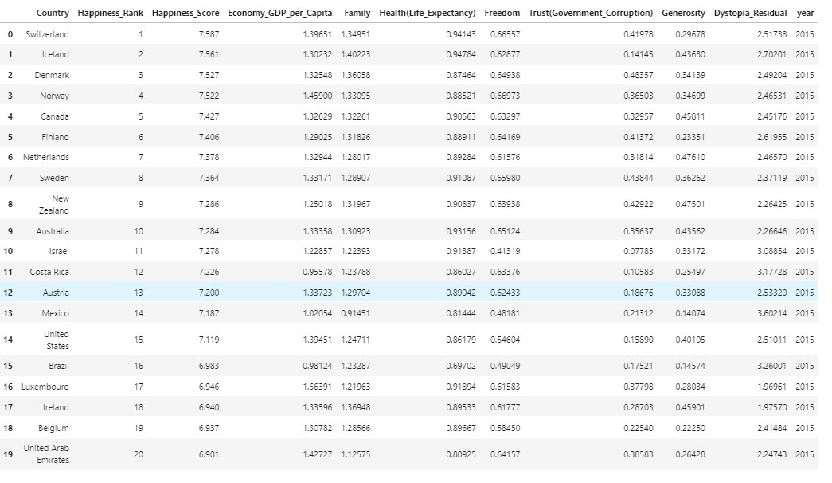
DATA SOURCE
https://www.kaggle.com/unsdsn/world-happiness
ANALYSIS
Conclusions are used by Governments for taking policy-making decisions
1.How factors affect each other(co-relation) ?
2.How factors affect overall Happiness index ?

Slide 4
METHODOLOGY
DATASET OVERVIEW
Happiness Rank
Economy_GDP per Capita
Trust (Government Corruption)
Happiness Score
Family
Health(Life
Expectancy)
Freedom
Generosity
Dystopia_Residual
Country
Examine the Data
Select the required Data
Apply individual regression between each two data category
Calculation of Co-relation and observing dependency between each two data categories from Scatterplots
Finding Co-relation between each factor with another and observe overall dependency of each factor with other factors
Fitting the PREDICTED Model
Conclusions

Slide 5
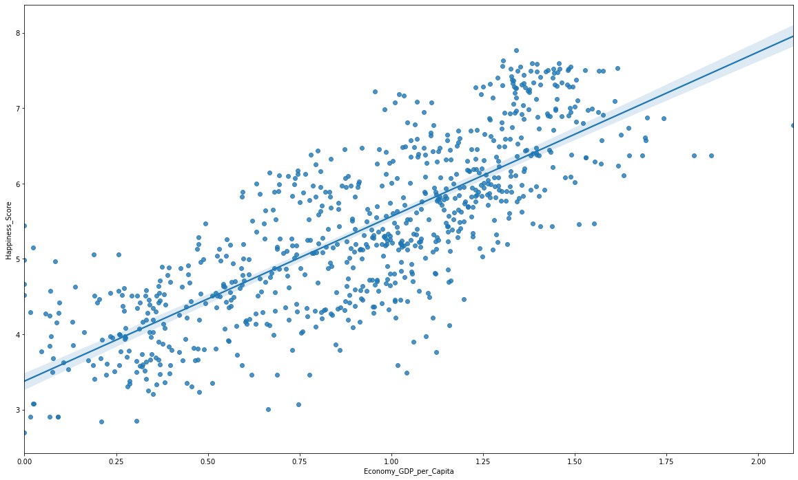

DATA SELECTION: 1
PLOTTING
GDP_PER_CAPITA
V/S
HAPPINESS SCORE
From Scatterplot, The data seems to have quite positive trend
This data has predicted co-relation of very high value 0.789284
Co-Relation Matrix | Economy_GDP_per_Capita | Happiness_Score
Economy_GDP_per_Capita | 1.000000 | 0.789284
Happiness_Score | 0.789284 | 1.000000

Slide 6
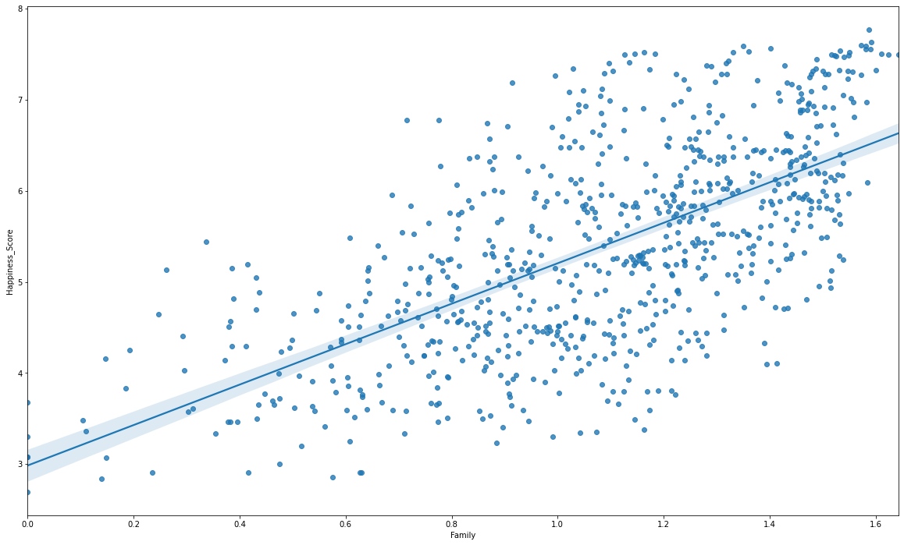
DATA SELECTION: 2
PLOTTING
Family
V/S
HAPPINESS SCORE
From Scatterplot, The data seems to have quite positive trend
This data has predicted co-relation of very high value 0.648799
Co-Relation Matrix | Family | Happiness_Score
Family | 1.000000 | 0.648799
Happiness_Score | 0.648799 | 1.000000

Slide 7
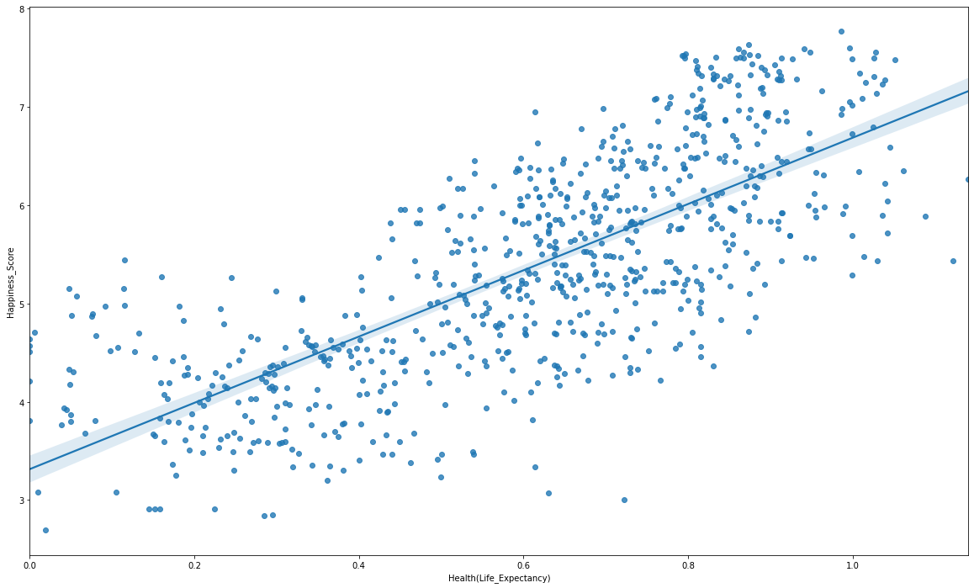
DATA SELECTION: 3
PLOTTING
Health(Life Expectancy)
V/S
HAPPINESS SCORE
From Scatterplot, The data seems to have quite positive trend
This data has predicted co-relation of value 0.742456
Co-Relation Matrix | Health(Life_Expectancy) | Happiness_Score
Health(Life_Expectancy) | 1.000000 | 0.742456
Happiness_Score | 0.742456 | 1.000000

Slide 8
DATA SELECTION: 4
PLOTTING
Freedom
V/S
HAPPINESS SCORE
From Scatterplot, The data seems to have quite positive trend
This data has predicted co-relation of value 0.551258
Co-Relation Matrix | Freedom | Happiness_Score
Freedom | 1.000000 | 0.551258
Happiness_Score | 0.551258 | 1.000000

Slide 9
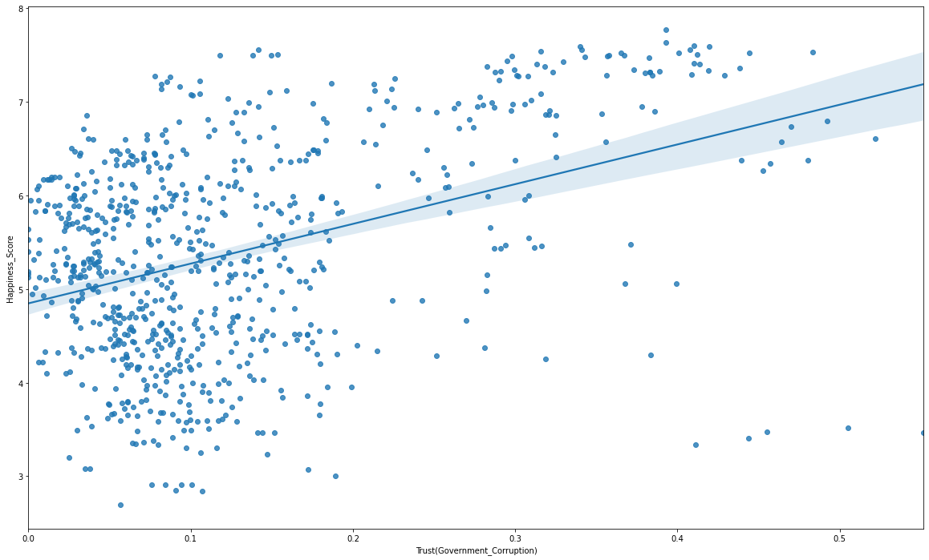
DATA SELECTION: 5
PLOTTING
Trust
(Government_Corruption)
V/S
HAPPINESS SCORE
From Scatterplot, The data seems to have quite positive trend
This data has predicted co-relation of value 0.398027
Co-Relation Matrix | Trust (Government_Corruption) | Happiness_Score
Trust (Government_Corruption) | 1.000000 | 0.398027
Happiness_Score | 0.398027 | 1.000000

Slide 10
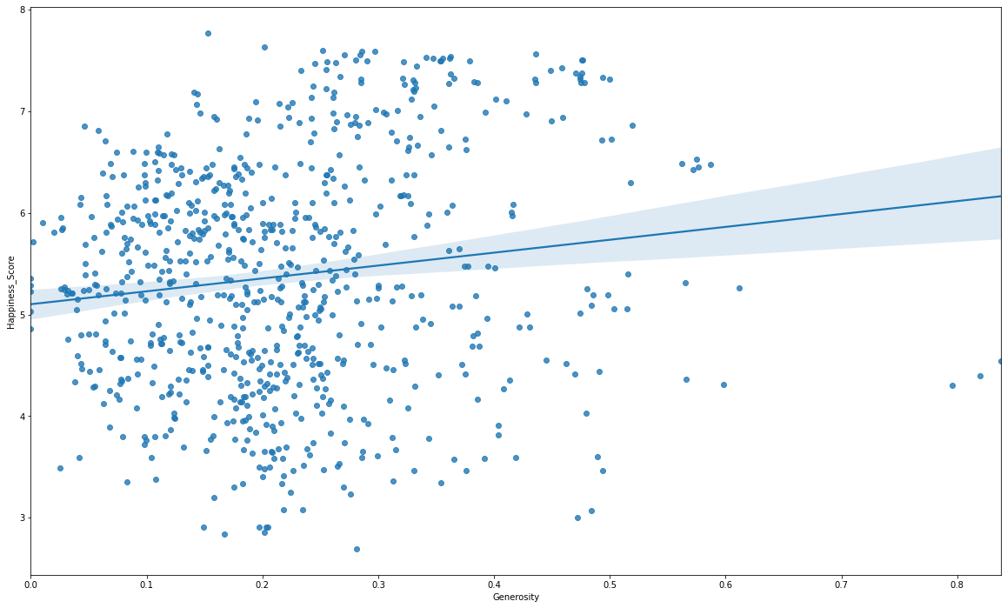
DATA SELECTION: 6
PLOTTING
Generosity
V/S
HAPPINESS SCORE
From Scatterplot, The data seems to have quite positive trend for lower values of Generosity
This data has predicted co-relation of lower value 0.137578, HENCE, IT FITS BASIC CONDITION OF Ommitted Variable
Co-Relation Matrix | Generosity | Happiness_Score
Generosity | 1.000000 | 0.137578
Happiness_Score | 0.137578 | 1.000000

Slide 11
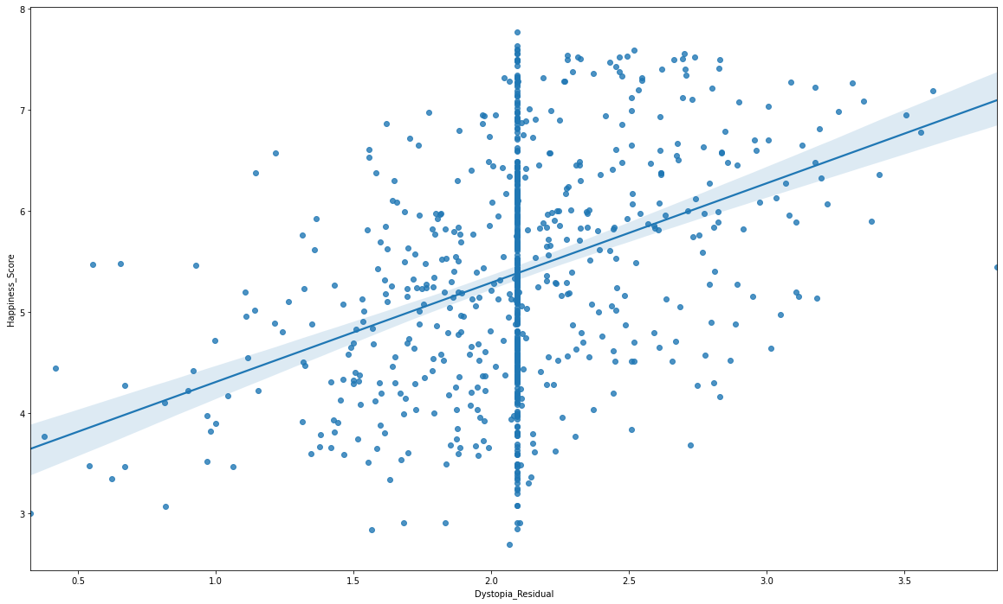
DATA SELECTION: 7
PLOTTING
Dystopia_Residual
V/S
HAPPINESS SCORE
From Scatterplot, The data seems to have quite mixed trend
This data has predicted co-relation of value 0.38273
Co-Relation Matrix | Dystopia_Residual | Happiness_Score
Dystopia_Residual | 1.000000 | 0.38273
Happiness_Score | 0.38273 | 1.000000

Slide 12
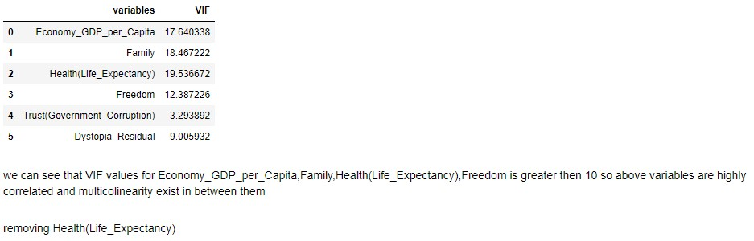
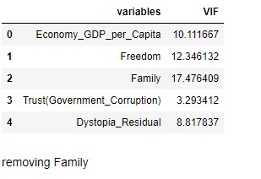
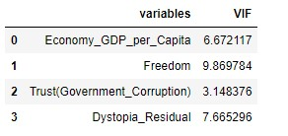
Checking Multi-Colinearity between Independent Variables
First we tried removing Health(Life Expectancy) & then Family independent variables resp.
This data has now no problem of multi-co-linearity, as it is eliminated by removing affected variables for building proper dataset for study !
12

Slide 13
FINDING OMITTED VARIABLES
Code:
linear('Generosity’)
## Relation is:
very less R2 value ..implies ..less dependency
Co-Relation Matrix | Generosity | Happiness_Score
Generosity | 1.000000 | 0.137578
Happiness_Score | 0.137578 | 1.000000
In our proposed model, we have declared variable: Generosity as OMMITTED VARIABLE !
We have also omitted possible variables like: Country-Size, Savings Mentality of citizens, Expenditure Behavior of citizens, etc. which are different for each person and for each country culture !

Slide 14
DATA FITTING:
invar = ['Economy_GDP_per_Capita','Family’,
'Health(Life_Expectancy)','Freedom’,
'Trust(Government_Corruption)’,
'Dystopia_Residual']
Z =df[inVar]
Y = df['Happiness_Score']
lm2 = LinearRegression()
lm2.fit(Z,Y)
print(lm2.coef_,
lm2.intercept_,lm2.score(Z,Y))
[1.09147152 0.82025526 0.847468 1.39622773 1.21404962 0.96276517]
0.2345622940490255 0.8983544424202508

Slide 15
DATA INTERPRETATION:
NOTE: ## very less R2 value .. ..less dependency
linear(‘VAR')
Variable | R2 Value
Economy_GDP_per_Capita | 0.6229692274601597
Family | 0.4209405897503018
Health(Life_Expectancy) | 0.5512405291325078
Freedom | 0.3038853857695216
Trust(Government_Corruption) | 0.1584252443105948
Dystopia_Residual | 0.14648245999409437
Generosity | 0.01892763285386556

Slide 16
CONCLUSION
NOTE: “Generosity” is OMMITTED Variable in our proposed Model.
Complete Co-relation matrix:
Happiness_Rank | Happiness_Score | Economy_GDP_per_Capita | Family | Health(Life_Expectancy) | Freedom | Trust(Government_Corruption) | Generosity | Dystopia_Residual | Year
Happiness_Score | 1.000000 | -0.992066 | -0.794791 | -0.644842 | -0.743655 | -0.537942 | -0.372377 | -0.117713 | -0.374882
Economy_GDP_per_Capita | -0.992066 | 1.000000 | 0.789284 | 0.648799 | 0.742456 | 0.551258 | 0.398027 | 0.137578 | 0.382730
Family | -0.794791 | 0.789284 | 1.000000 | 0.585966 | 0.784338 | 0.340511 | 0.304655 | -0.014560 | 0.023787
Health(Life_Expectancy) | -0.644842 | 0.648799 | 0.585966 | 1.000000 | 0.572650 | 0.420361 | 0.126333 | -0.037262 | -0.061107
Freedom | -0.743655 | 0.742456 | 0.784338 | 0.572650 | 1.000000 | 0.340745 | 0.250503 | 0.010638 | 0.043227
Trust(Government_Corruption) | -0.537942 | 0.551258 | 0.340511 | 0.420361 | 0.340745 | 1.000000 | 0.459390 | 0.290706 | 0.029283
Generosity | -0.372377 | 0.398027 | 0.304655 | 0.126333 | 0.250503 | 0.459390 | 1.000000 | 0.318905 | 0.000001
Dystopia_Residual | -0.117713 | 0.137578 | -0.014560 | -0.037262 | 0.010638 | 0.290706 | 0.318905 | 1.000000 | -0.095392
Year | -0.374882 | 0.382730 | 0.023787 | -0.061107 | 0.043227 | 0.029283 | 0.000001 | -0.095392 | 1.000000
There is co-relation between each parameter with every other parameter. As found in beside table, using Regression Techniques
There is co-relation between each parameter with every other parameter. As found in beside table, using Regression Techniques
Every variable except “Generosity” has significant impact on Objective functon “Happiness Score”. Hence, we have OMMITTED Generosity variable !

Slide 17
Codes used:
NOTE: Here, in codes, variable under study can take values: Economy, Family, Health,Freedom, etc
Code | Application | Use Locations
def scatter(c): {plt.figure(figsize=(20,12)) sns.regplot(x=c,y="Happiness_Score", data=df) } | Defining function scatter, Using which, scatter command creates scatteplots wherever recalled !
scatter(‘variable under study') | Plotting Scatterplot between Happiness Score & given factor(parameter in consideration under study) | Page No.12
df[[variable under study','Happiness_Score']].corr() | Finding co-relation between given pair of factors(parameters in consideration under study) | Page No.12
df.corr() | Finding co-relation between every pair of factors(parameters in consideration under study) | Page No.12
def linear(var): y = df['Happiness_Score'] z = df[[var]] lm1 = LinearRegression() lm1.fit(z,y) return lm1.coef_,lm1.intercept_,lm1.score(z,y),(np.sqrt((y-lm1.predict(z))**2/(y.count()-2))).mean() | Creating Linear Regression function of given input Variable with “Happiness Score” & Calculating (Slope, Intercept, Happiness Score, R Square Values) After calling this method wherever
linear(‘var') | Performing Linear Regression of given “input variable” with “Happiness Score” | Page No. 5 to 11

Slide 18
Codes used:
NOTE: Here, in codes, variable under study can take values: Economy, Family, Health,Freedom, etc
Code | Application | Use Locations
invar =['Economy_GDP_per_Capita','Family’,'Health(Life_Expectancy)','Freedom','Trust(Government_Corruption)','Dystopia_Residual’ ] Z =df[inVar] Y = df['Happiness_Score'] | Defining invar as list container for all variables under study | Page No.13
lm2 = LinearRegression() lm2.fit(Z,Y) print(lm2.coef_,lm2.intercept_,lm2.score(Z,Y)) | Performing Linear Regression & Trying to FIT PREDICTED MODEL WITH ACTUAL DATA | Page No.13
df.head(3) | Define only first 3 rows in result | Page No.14

Slide 19
Terms used:
NOTE: Here, in codes, variable under study can take values: Economy, Family, Health,Freedom, etc
Terms | Meaning
What is Dystopia? | Dystopia is an imaginary country that has the world’s least-happy people. The purpose in establishing Dystopia is to have a benchmark against which all countries can be favorably compared (no country performs more poorly than Dystopia) in terms of each of the six key variables, thus allowing each sub-bar to be of positive width.
What are the residuals? | The residuals, or unexplained components, differ for each country, reflecting the extent to which the six variables either over- or under-explain average 2014-2016 life evaluations. These residuals have an average value of approximately zero over the whole set of countries.

Slide 20

THANK YOU !

